Slide 1




Integration of building and environmental data for fire emergency response operations
Eyosias Guyo^{1,2}, Timo Hartmann¹
1. Technische Universität Berlin, Berlin, Germany
2. Trimble Solutions Oy, Espoo, Finland
W3C LBD Community Group
18 September 2023, Virtual
This work was supported by the CBIM-ETN funded by the European Union’s Horizon 2020 research and innovation programme under the Marie Skłodowska-Curie grant agreement No 860555.
Notes:
Color schemes: Four
Complimentary colors

Slide 2
About me
PhD Researcher at Trimble, Nov 2020
Joined Trimble as a part of a PhD training program within the CBIM network.
Assisting in a Product Owner role since May 2023
Academic Background
MSc in Structural Engineering (Thesis: Incorporating BIM into the workflow of structural engineers)
Phd in Civil Engineering (On-going), Technische Universität Berlin
Research topic: Integration of building and environmental data
Professional Background before Trimble
Structural engineer at a design Firm
Lecture and Academic research assistance at two universities
Some experience in programming (Developed two applications in previous employment)

Slide 3


CBIM - GA No. 680676

Slide 4

Research Motivation: Fire Emergency Response
Fire hazards lead to more casualties than many other types of disasters (Coppola, 2015)
Firefighters:
Safeguard occupants
Reduce property damage
Protect themselves
Availability and quality of data is critical

Slide 5
Data Needed by Emergency Service Providers
Data is needed for:
Routing and navigation
Assessing the hazard
Determining required resources
Utilising building safety features
Identifying potential hazards to firefighters
Post-incident analysis

Slide 6
Challenges of Acquiring Data
Unknown environment
Mentally stressful & physically demanding work
Limited visibility
High reliance on signs
Paper based data sources
Outdated & static
Destressed civilian
Human error
Complexity of structures

Slide 7







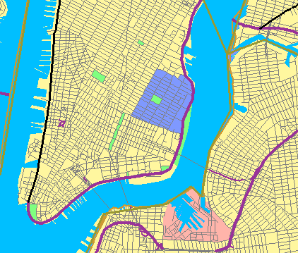
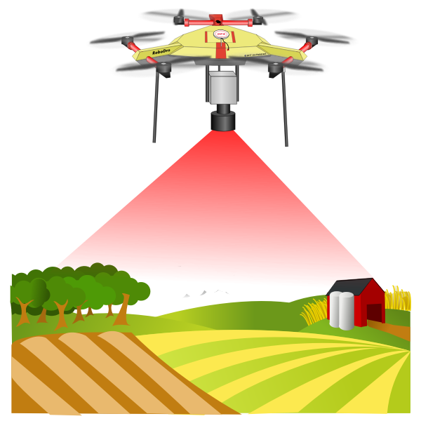
Research Gap
Prior research focus on investigating information sources
Building Information Models
Sensors
Ground uncrewed vehicles
Extended reality gadgets
Geographic Information System
Personal protective equipment
Aerial uncrewed vehicles

Slide 8
Research Gap: Data Exchange Challenges
Only a limited number have addressed the integration of information technologies (Weidinger, 2022).
Firefighters are divided into multiple units
Exchange of data between these teams is required
Firefighters interact with other emergency service responders (police, paramedic,…)
Lacking a consistent nomenclature for referring to different concepts hinders communication during emergency response efforts (NFPA, 2018).
Most equipment utilized in response operation exhibit limited interoperability among one another (Hamins et al., 2014)
Integration between information technologies presents a significant challenge since they originated from different domains.

Slide 9
Research Questions
How can a formal, well-defined, and shared understanding of the building fire emergency response domain be established?
Ontologies can be used to develop a formal and structured description of shared knowledge within a particular domain (Noy and McGuinness, 2001).
Shared understanding enhances communication among individuals and organizations and promotes interoperability between systems (Uschold and Gruninger, 1996).
Introduced A novel ontology: Firefighters’ Data Requirement Ontology (Guyo et al. 2023)

Slide 10
Ontology Development: METHONTOLOGY (Fernandez, Gómez-Pérez, and Juristo 1997)
Specification
Knowledge Acquisition
Conceptualisation
Implementation
Evaluation
Documentation

Slide 11
Specification
Domain: Building fire emergency
Purpose: Representing knowledge related with firefighters information needs.
Scope: The focus is on data about an affected building, its different components, and its surrounding.
Intended use:
Facilitate the data exchange process between different organization involved in emergency response as well as interoperability between systems used in the domain.
A basis for developing new information systems for the domain.
To develop ontology-based data checking systems for building and city datasets

Slide 12
Competency Questions
What information about an affected building is required by firefighters to decide how much resource is required?
Which environmental features at an incident site can interfere with firefighters’ actions?
Which building and environmental features can cause injury to firefighters?
What information about fire suppression equipment (such as fire hydrants) is needed in order to operate them?
What are the building safety systems that can support firefighters and how can they be controlled?
And more

Slide 13
Knowledge Acquisition
Specification
Knowledge Acquisition

Slide 14
Knowledge Acquisition
International codes | The international building code (ICC, 2018a) The international fire code (ICC, 2018b) NFPA 1620: Standard for Pre-Incident Planning
Scientific papers | Jones et al. (2005) (Workshop with 25 first responders), Li et al. (2014) (Workshop with 29 first responders) Heron et al. (2003), Isikdag, Underwood and Aouad (2008), Ghodrat et al. (2021), Santarpia et al. (2019),
Manual | Occupational safety and health administration (2015)
Notes:
Li et al. (2014) with first responder participants to evaluate firefighters’ information need during a building fire emergency response;
Isikdag et al. (2008) where data requirements for a successful fire response management operation were identified;
Jones et al. (2005):- a workshop conducted by the National Institute of Standards and Technology (NIST) with 25 participants on the information need of first responders
And multiple studies regarding environmental factors

Slide 15
Answers to Competency Questions
Data about the affected building that is relevant for firefighters’ operations, such as building occupancy, construction type, building height, and the number of stories.
Data about any potential hazards in the building and its surroundings, such as chemical storage, gas tanks and powerlines.
Data about different building and environmental fire suppression equipment that firefighters use such as fire hydrants, fire department connections, standpipes, fire hose connections, and fire pumps.
Data about different building fire protection and suppression systems, such as fire alarm systems, automatic sprinkler systems, and smoke control systems
And more

Slide 16


Knowledge Acquisition
Terms that should be included in the ontology.
Glossary of Terms

Slide 17
Conceptualisation
Specification
Knowledge Acquisition
Conceptualisation

Slide 18
Conceptualisation
Structure the gathered domain knowledge in a conceptual model.
Terms that identify an object – Classes
Terms that describe an object - Properties.
Classes structured based on their relationship
International codes are used to generate concise and consistent names.

Slide 19
Ontology Development
Specification
Knowledge Acquisition
Implementation
Conceptualisation

Slide 20
Implementation
Implementing the ontology in a formal language.
The web ontology language (OWL) was used
Protégé 5.5.0, was used as the development environment to create the OWL file.
Notes:
OWL can represent the meaning of terms and the relationship between terms in a machine-interpretable language.

Slide 21
Ontology Development
Specification
Knowledge Acquisition
Implementation
Conceptualisation
Evaluation

Slide 22
Evaluation
Verification
Validation
Confirms the correctness of an ontology
Protégé Resoners
OOps!
Confirms whether an ontology corresponds to the concepts it was modelled to represent
Workshop with firefighters
Prototype
Notes:
Verification is the technical process that confirms the correctness of an ontology.
Validation is the process that confirms whether an ontology corresponds to the concepts it was modelled to represent.

Slide 23
Ontology Verification
The evaluation of the correctness and consistency of the new ontology.
Reasoning on the ontology with Pellet and HermiT identified a few logical inconsistencies.
Ontology pitfall scanner! or OOPS! is used to identify pitfalls in the ontology.
Verification processes repeated every time the ontology is modified.
Notes:
OWL can represent the meaning of terms and the relationship between terms in a machine-interpretable language.

Slide 24
Ontology Validation: Prototype
A prototype web application that visualises relevant information based on the ontology is developed.
Developed using the Django framework
Owlready2 is used in the python script to parse the ontology from OWL format in Python.
A thirteen-floor office building in Espoo, Finland, is selected as a case study
Notes:
OWL can represent the meaning of terms and the relationship between terms in a machine-interpretable language.

Slide 25
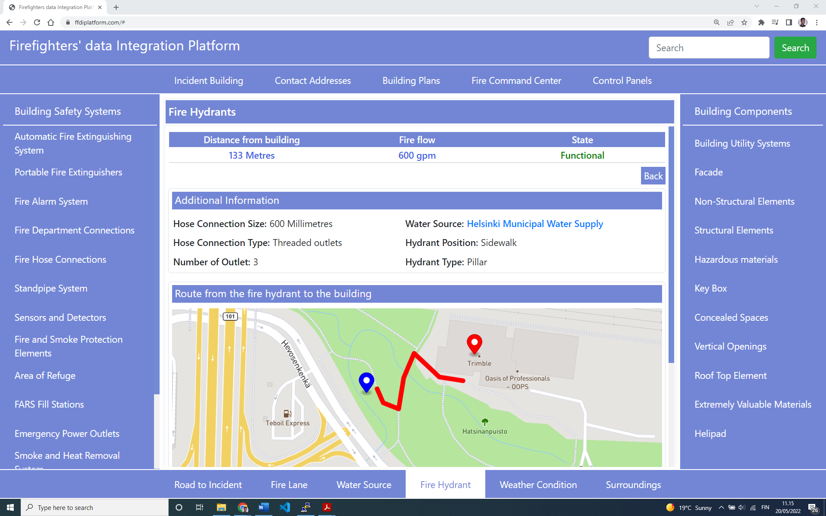
https://github.com/Eyosias24/FFDR_Ontology_Implementation_Prototype

Slide 26
Ontology Validation: Firefighter Interview
Interviews with firefighters to assess the ontology.
Interview identified some concepts missing in the ontology.
Modifications are made to the ontology to address the issue.
Notes:
OWL can represent the meaning of terms and the relationship between terms in a machine-interpretable language.

Slide 27
Ontology Development
Specification
Knowledge Acquisition
Implementation
Conceptualisation
Evaluation
Documentation

Slide 28
Documentation
Ontology specification document published online.
Live OWL Documentation Environment (LODE) (Peroni, Shotton, and Vitali 2012)
Wizard for documenting ontologies (WIDOCO) (Garijo 2022)
IRI: https://purl.org/ffdr-ontology
Notes:
OWL can represent the meaning of terms and the relationship between terms in a machine-interpretable language.

Slide 29
Benefits of the Research
The ontology provides a shared, structured, and deeper understanding of the fire emergency domain
Support to standardization efforts in the emergency management domain
Facilitate effective communication and information management during emergency response operations
Enhances interoperability among information systems and technologies that can be used throughout the emergency management
Support development of systems that gather and provide comprehensive information to firefighters

Slide 30

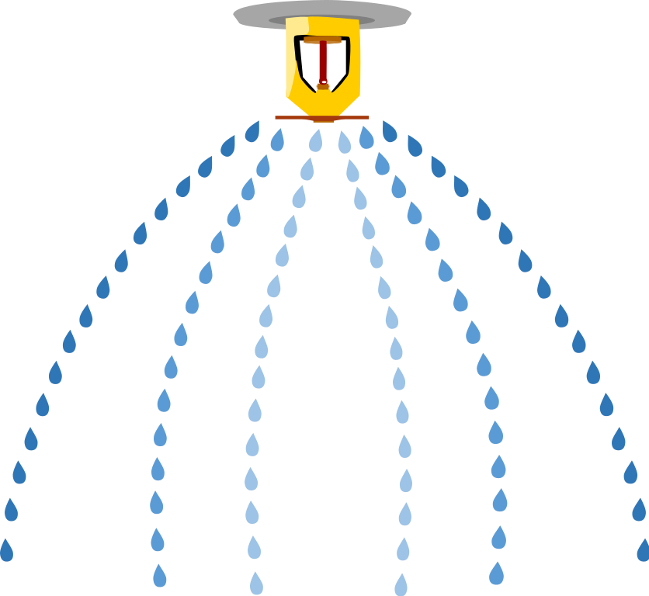
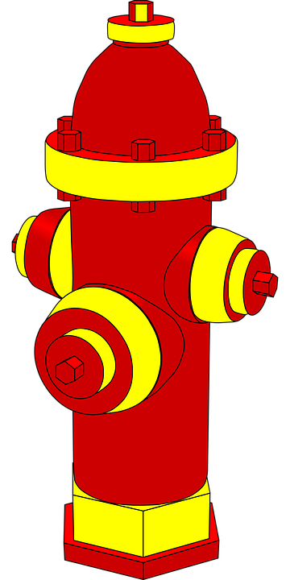


Benefits of the Research

Slide 31
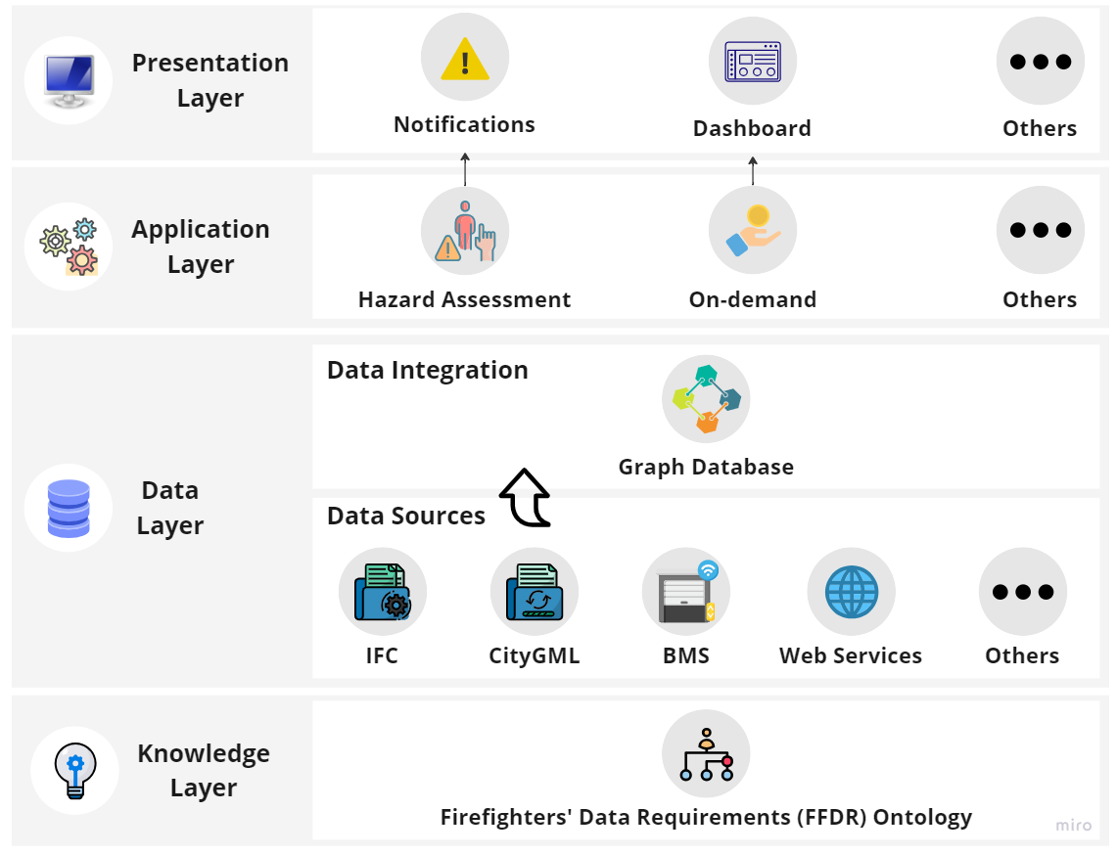
Data Integration Framework

Slide 32

Data Integration Framework
Building
Static
IFC
Live
BMS
Environment
Static
CityGML
Live
Web Services

Slide 33
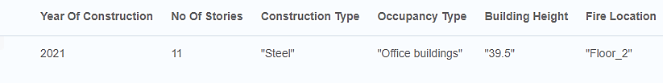
Data Integration Framework
An automated assessment for critical data
Building Model
City Model
BMS

Slide 34
Data Integration Framework
2. On-demand access to the unified data
Fire hydrants that are found near the affected building
Location (Coordinates) | Distance | Type | Diameter
24.819843, 60.217317 | 300 | underground | 600
24.82183, 60.216087 | 300 | pillar | 300
24.82398, 60.216246 | 400 | underground | -
24.820965, 60.215392 | 400 | underground | -
24.823942, 60.215375 | 500 | underground | -
24.8261, 60.2152 | 600 | underground | 300

Slide 35
Additional Benefits of the Research
The ontology extends its benefits to other stakeholders responsible for the safety of building occupants
Offers imperative knowledge that is required for a better understanding of building safety
Building designers can devise designs that ensure the safety of first responders
Building managers and regulatory bodies can conduct conformity checks regarding the fire safety of buildings based on the knowledge in the ontology.
Automated rule-checking systems based on the ontology

Slide 36
Other Activities in the Research
Comparative study of relational and graph-based data persistent systems
We experimented with four datasets
Two building datasets - large and small
Two city datasets - large (Tokyo) and small (Espoo)
Compared Graph DB and Relational DB based on:
Database design and maintenance
Query performance

Slide 37
References
Altowaijri, Abdullah H. et al. 2021. “A Privacy-Preserving Iot-Based Fire Detector.” IEEE Access 9: 51393–402. https://click.endnote.com/viewer?doi=10.1109%2Faccess.2021.3069588&token=WzMxMjI5NzYsIjEwLjExMDkvYWNjZXNzLjIwMjEuMzA2OTU4OCJd.JZFmqHKBZWA6KnbrL8F5UE_c7R8 (February 24, 2023).
Balaji, Bharathan et al. 2016. “Brick: Towards a Unified Metadata Schema For Buildings.” In Proceedings of the 3rd ACM International Conference on Systems for Energy-Efficient Built Environments, New York, NY, USA: ACM, 41–50. https://dl.acm.org/doi/10.1145/2993422.2993577.
Balding, Dave. 2020. “Embracing Technology - Fire Fighting in Canada.” https://www.firefightingincanada.com/embracing-technology/ (August 2, 2021).
Bitencourt, Kattiuscia, Frederico Araújo Durão, Manoel Mendonça, and Lassion Laique Bomfim de Souza Santana. 2018. “An Ontological Model for Fire Emergency Situations.” In IEICE Transactions on Information and Systems, Institute of Electronics, Information and Communication, Engineers, IEICE, 108–15.
Burel, Grégoire, Lara S.G. Piccolo, Kenny Meesters, and Harith Alani. 2017. “DoRES-A Three-Tier Ontology for Modelling Crises in the Digital Age.” In Proceedings of the International ISCRAM Conference, , 834–45.
Ehrlinger, Lisa;, and Wolfram Wöß. 2016. “Towards a Definition of Knowledge Graphs.” In Joint Proceedings of the Posters and Demos Track of 12th International Conference on Semantic Systems - SEMANTiCS2016 and 1st International Workshop on Semantic Change & Evolving Semantics (SuCCESS16), Leipzig. https://www.researchgate.net/publication/323316736_Towards_a_Definition_of_Knowledge_Graphs (February 22, 2023).
Fahy, R., J. Petrolli, and J. Molis. 2019. NFPA Research Report NFPA: Firefighter Fatalities in the US-2019. https://www.nfpa.org/News-and-Research/Data-research-and-tools/Emergency-Responders/Firefighter-fatalities-in-the-United-States.
Fan, Zhengjie, and Sisi Zlatanova. 2011. “Exploring Ontologies for Semantic Interoperability of Data in Emergency Response.” Applied Geomatics 3(2): 109–22. http://link.springer.com/10.1007/s12518-011-0048-y (August 10, 2021).
Fernandez, M., A. Gómez-Pérez, and Natalia Juristo. 1997. “Methontology: From Ontological Art towards Ontological Engineering.” In Proceedings of the AAAI97 Spring Symposium Series on Ontological Engineering, Facultad de Informática (UPM), 33–40. http://speech.inesc.pt/~joana/prc/artigos/06c METHONTOLOGY from Ontological Art towards Ontological Engineering - Fernandez, Perez, Juristo - AAAI - 1997.pdf (August 16, 2021).

Slide 38
References
Gang Liu et al. 2011. “Towards Building Ontology for Community-Based Fire Management.” In Proceedings 2011 International Conference on Transportation, Mechanical, and Electrical Engineering (TMEE), IEEE, 1366–69. http://ieeexplore.ieee.org/document/6199460/.
Garijo, Daniel. 2022. “WIDOCO: A Wizard for Documenting Ontologies.” https://zenodo.org/record/6470043 (July 20, 2022).
Gaur, Manas, Saeedeh Shekarpour, Amelie Gyrard, and Amit Sheth. 2019. “Empathi: An Ontology for Emergency Managing and Planning About Hazard Crisis.” In 2019 IEEE 13th International Conference on Semantic Computing (ICSC), IEEE, 396–403. https://ieeexplore.ieee.org/document/8665539/.
Ghadi, Yazeed Yasin, M. G. Rasul, and M. M.K. Khan. 2016. “Design and Development of Advanced Fuzzy Logic Controllers in Smart Buildings for Institutional Buildings in Subtropical Queensland.” Renewable and Sustainable Energy Reviews 54: 738–44. http://dx.doi.org/10.1016/j.rser.2015.10.105.
Ghodrat, Maryam, Farshad Shakeriaski, David James Nelson, and Albert Simeoni. 2021. “Existing Improvements in Simulation of Fire–Wind Interaction and Its Effects on Structures.” Fire 4(27). https://www.mdpi.com/2571-6255/4/2/27.
Glimm, Birte et al. 2014. “HermiT: An OWL 2 Reasoner.” Journal of Automated Reasoning 53(3): 245–69. https://link.springer.com/article/10.1007/s10817-014-9305-1 (November 10, 2022).
Gómez-Pérez, Asunción, Mariano Fernández, and A de Vicente. 1996. “Towards a Method to Conceptualize Domain Ontologies.” In Ontological Engineering 12th European Conference on Artificial Intelligence (ECAI’96), , 41–51.
Hartmann, Timo, and Amy Trappey. 2020. “Advanced Engineering Informatics - Philosophical and Methodological Foundations with Examples from Civil and Construction Engineering.” Developments in the Built Environment 4: 100020.
Heron, Dave et al. 2003. New Zealand Fire Service Commission Research Report Number 44 Modelling Fire-Spread In and Around Urban Centres.
International Code Council (ICC). 2018a. 2018 International Building Code. International Code Council, Inc.
———. 2018b. 2018 International Fire Code. International Code Council, Inc.
Isikdag, Umit, Jason Underwood, and Ghassan Aouad. 2008. “An Investigation into the Applicability of Building Information Models in Geospatial Environment in Support of Site Selection and Fire Response Management Processes.” Advanced Engineering Informatics 22(4): 504–19. http://dx.doi.org/10.1016/j.aei.2008.06.001.

Slide 39
References
Jones, Walter W et al. 2005. National Institute of Standards and Technology Workshop to Define Information Needed by Emergency Responders during Building Emergencies. Gaithersburg, MD. http://fire.nist.gov/bfrlpubs/fire05/art017.html.
Khalid, Qasim. 2021. “SBEO: Smart Building Evacuation Ontology. Version: 0.2.” https://qasimkhalid.github.io/SBEO/ (August 13, 2021).
Laakso, Mikael, and Arto Kiviniemi. 2012. “The IFC Standard - A Review of History, Development, and Standardization.” Journal of Information Technology in Construction (ITcon) 17: 134–61.
Lamy, Jean-Baptiste. 2017. “Owlready: Ontology-Oriented Programming in Python with Automatic Classification and High Level Constructs for Biomedical Ontologies.” Artificial Intelligence in Medicine 80: 11–28. http://www.lesfleursdunormal.fr/static/_downloads/article_owlready_aim_2017.pdf.
Li, Nan et al. 2014. “Situational Awareness for Supporting Building Fire Emergency Response: Information Needs, Information Sources, and Implementation Requirements.” Fire Safety Journal 63: 17–28. http://dx.doi.org/10.1016/j.firesaf.2013.11.010.
Malizia, A. et al. 2010. “SEMA4A: An Ontology for Emergency Notification Systems Accessibility.” Expert Systems with Applications 37(4): 3380–91. https://linkinghub.elsevier.com/retrieve/pii/S0957417409008768 (August 11, 2021).
McGuinness, Deborah L, and Frank van Harmelen. 2004. “OWL Web Ontology Language Overview” eds. Deborah L McGuinness and Frank Van Harmelen. W3C recommendation 10(February). http://www.w3.org/TR/owl-features/.
Musen, Mark A. 2015. “The Protégé Project: A Look Back and a Look Forward.” AI Matters 1(4): 4–12. https://dl.acm.org/doi/10.1145/2757001.2757003.
National Fire Protection Association (NFPA). 2020. NFPA 1620: Standard for Pre-Incident Planning. https://www.nfpa.org/codes-and-standards/all-codes-and-standards/list-of-codes-and-standards/detail?code=1620.
———. 2021. NFPA Glossary of Terms.
National Wildfire Coordinating Group (U.S.). 1994. Fire Effects Guide. Washington, D.C.: National Wildlife Coordinating Group. file://catalog.hathitrust.org/Record/002916608.
Neto, Joaquim, António Jorge Do Nascimento Morais, Ramiro Gonçalves, and António Coelho. 2021. “An Ontology for Fire Building Evacuation.” In ICICT 2021 - 6th International Congress on Information & Communication Technology,.

Slide 40
References
Noy, Natalya F., and Deborah L. McGuinness. 2001. Stanford Knowledge Systems Laboratory Ontology Development 101: A Guide to Creating Your First Ontology.
Nuo, Noel, Wi Tay, Naoyuki K Ubota, and János Botzheim. 2016. “Building Ontology for Fire Emergency Planning and Support.” E-Journal of Advanced Maintenance 8(2): 13–22.
Occupational Safety and Health Administration (OSHA). 2015. Fire Service Features of Buildings and Fire Protection Systems.
Onorati, T., A. Malizia, P. Diaz, and I. Aedo. 2014. “Modeling an Ontology on Accessible Evacuation Routes for Emergencies.” Expert Systems with Applications 41(16): 7124–34. https://linkinghub.elsevier.com/retrieve/pii/S0957417414003194 (January 31, 2021).
Open Geospatial Consortium. 2012. OGC Document No. 12-019 OpenGIS City Geography Markup Language (CityGML) Encoding Standard, Version 2.0.0. eds. Gerhard Gröger, Thomas H. Kolbe, Claus Nagel, and Karl-Heinz Häfele. https://portal.opengeospatial.org/files/?artifact_id=47842.
Pauwels, Pieter, and Walter Terkaj. 2016. “EXPRESS to OWL for Construction Industry: Towards a Recommendable and Usable IfcOWL Ontology.” Automation in Construction 63: 100–133. https://technical.buildingsmart.org/standards/ifc/ifc-formats/ifcowl/ (November 10, 2022).
Peroni, Silvio, David Shotton, and Fabio Vitali. 2012. “The Live OWL Documentation Environment: A Tool for the Automatic Generation of Ontology Documentation.” In Proceedings of the 18th International Conference on Knowledge Engineering and Knowledge Management, http://speroni.web.cs.unibo.it/publications/peroni-2012-live-documentation-environment.pdf (July 20, 2022).
Poveda-Villalón, María, Asunción Gómez-Pérez, and Mari Carmen Suárez-Figueroa. 2014. “OOPS! (OntOlogy Pitfall Scanner!).” International Journal on Semantic Web and Information Systems 10(2): 7–34. http://services.igi-global.com/resolvedoi/resolve.aspx?doi=10.4018/ijswis.2014040102.
Rasmussen, Mads Holten, Maxime Lefrançois, Georg Ferdinand Schneider, and Pieter Pauwels. 2020. “BOT: The Building Topology Ontology of the W3C Linked Building Data Group” ed. Krzysztof Janowicz. Semantic Web 12(1): 143–61. https://www.medra.org/servlet/aliasResolver?alias=iospress&doi=10.3233/SW-200385.
Rauch, Nadia, and Mark Fox. 2017. A Fire and Emergency Ontology for City Indicators.
Saad, Elie, Koen V. Hindriks, and Mark A. Neerincx. 2018. “Ontology Design for Task Allocation and Management in Urban Search and Rescue Missions.” In Proceedings of the 10th International Conference on Agents and Artificial Intelligence, SCITEPRESS - Science and Technology Publications, 622–29. http://www.scitepress.org/DigitalLibrary/Link.aspx?doi=10.5220/0006661106220629 (August 10, 2021).

Slide 41
References
Santarpia, Luciano et al. 2019. “Fire Temperature Based on the Time and Resistance of Buildings—Predicting the Adoption of Fire Safety Measures.” Fire 2(2): 19. https://www.mdpi.com/2571-6255/2/2/19.
Sassani, Bahman A. et al. 2020. “FireNot – An IoT Based Fire Alerting System: Design and Implementation.” Journal of Ambient Intelligence and Smart Environments 12(6): 475–89. https://www.medra.org/servlet/aliasResolver?alias=iospress&doi=10.3233/AIS-200579 (February 24, 2023).
Sirin, Evren et al. 2007. “Pellet: A Practical OWL-DL Reasoner.” Journal of Web Semantics 5(2): 51–53.
Uschold, Mike, and Michael Gruninger. 1996. “Ontologies: Principles, Methods and Applications.” The Knowledge Engineering Review 11(2): 93–136. https://www.cambridge.org/core/journals/knowledge-engineering-review/article/abs/ontologies-principles-methods-and-applications/2443E0A8E5D81A144D8C611EF20043E6 (February 22, 2023).
Vilgertshofer, S. et al. 2017. “Linking BIM and GIS Models in Infrastructure by Example of IFC and CityGML.” In ASCE International Workshop on Computing in Civil Engineering 2017, American Society of Civil Engineers (ASCE), 133–40.
Vinasco-Alvarez, D., J. Samuel, S. Servigne, and G. Gesquière. 2020. LIRIS UMR 5205 From CityGML to OWL.
Wehbe, Rania, and Isam Shahrour. 2021. “A BIM-Based Smart System for Fire Evacuation.” Future Internet 13(9): 221. https://www.mdpi.com/1999-5903/13/9/221.
Xu, Wei, and Sisi Zlatanova. 2007. “Ontologies for Disaster Management Response.” In Geomatics Solutions for Disaster Management, eds. Jonathan; Li, Sisi; Zlatanova, and Andrea G. Fabbri. Berlin, Heidelberg: Springer Berlin Heidelberg, 185–200. http://link.springer.com/10.1007/978-3-540-72108-6_13.

Slide 42




Thank you!
Eyosias Dawit Guyo
eyosias.guyo@trimble.com

